Slide 1
Chapter 3: Digital Logic Structures
Source:
Introduction to Computing Systems from bits & gates to C & beyond (McGraw-Hill, 2004)

Slide 2
Topics for Discussion
The Transistor
Logic Gates
Combinational Logic Circuits
Basic Storage Elements
Memory
Sequential Logic Circuits
LC-3 Data Path

Slide 3
The Transistor
MOS (metal oxide semiconductor) transistors are used to make or break a closed circuit
N-type
P-type
CMOS: complementary metal-oxide semiconductor

Slide 4
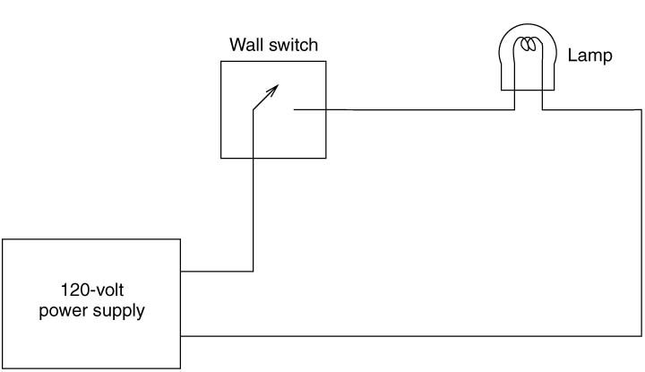
Figure 3.1 A Simple Electric Switch

Slide 5
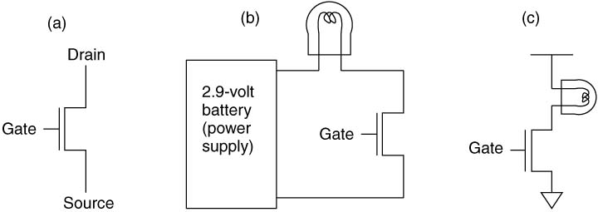
Figure 3.2 the n-type MOS Transistor

Slide 6
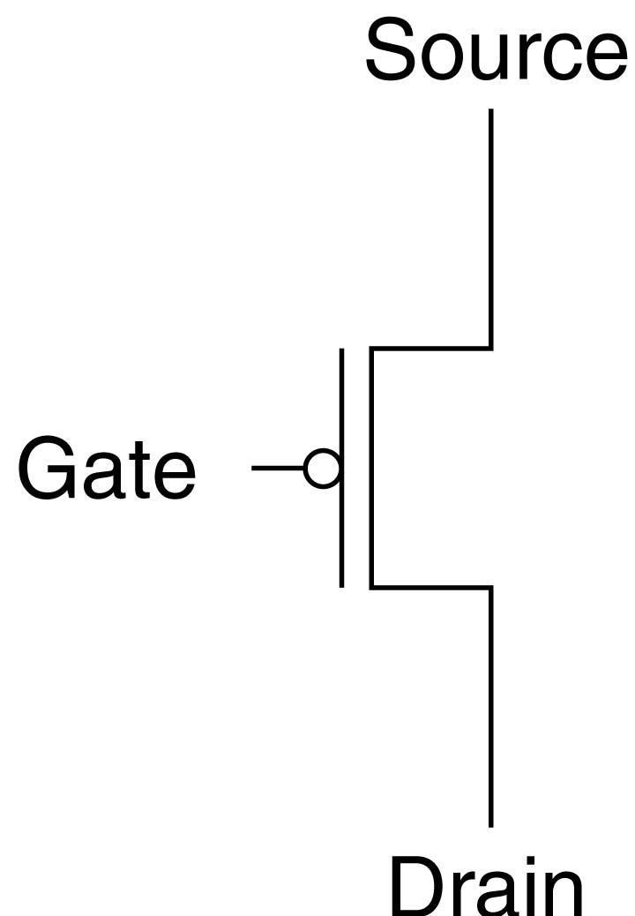
Figure 3.3 A p-type MOS Transistor

Slide 7
Logic Gates
NOT (Inverter)
OR and NOR
AND and NAND

Slide 8
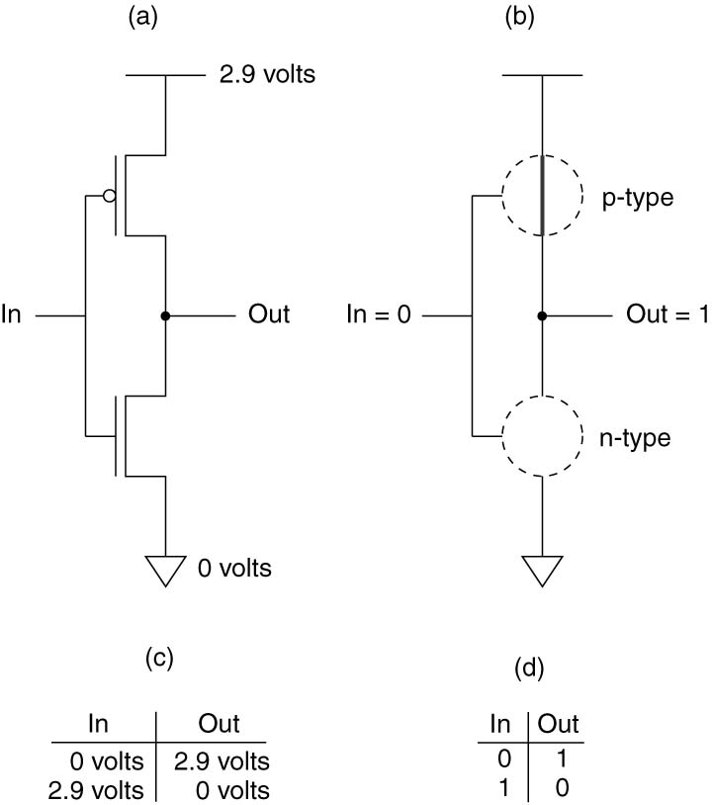
Figure 3.4 A CMOS Inverter

Slide 9
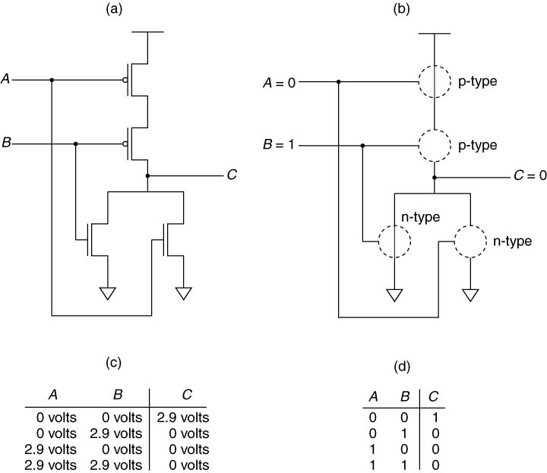
Figure 3.5 The NOR Gate

Slide 10
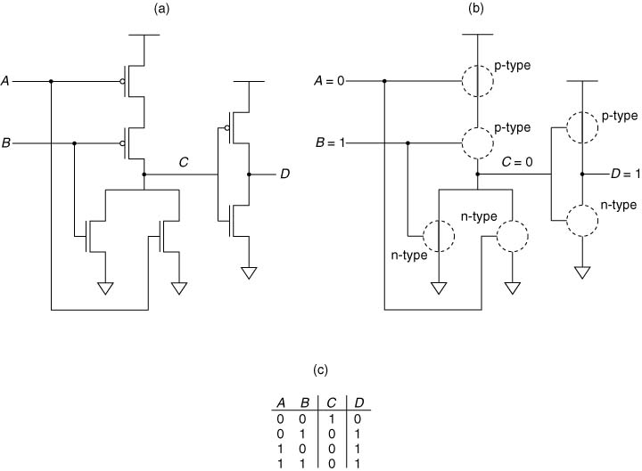
Figure 3.6 The OR Gate

Slide 11
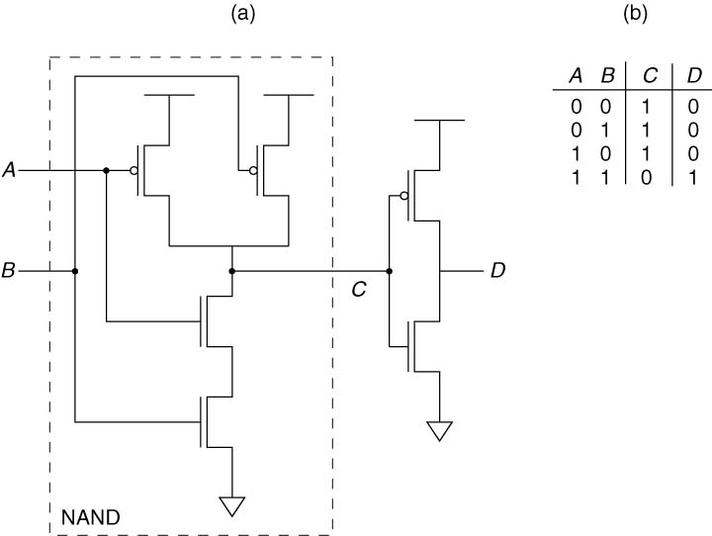
Figure 3.7 The AND Gate

Slide 12
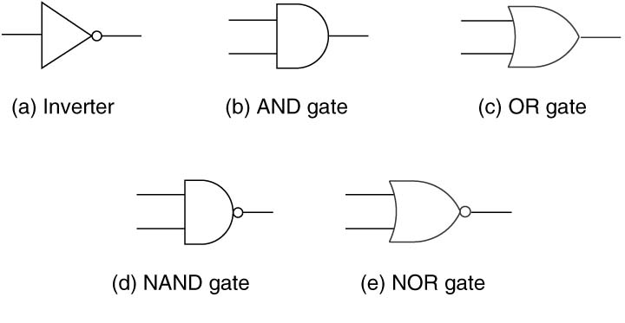
Figure 3.8 Basic Logic Gates

Slide 13
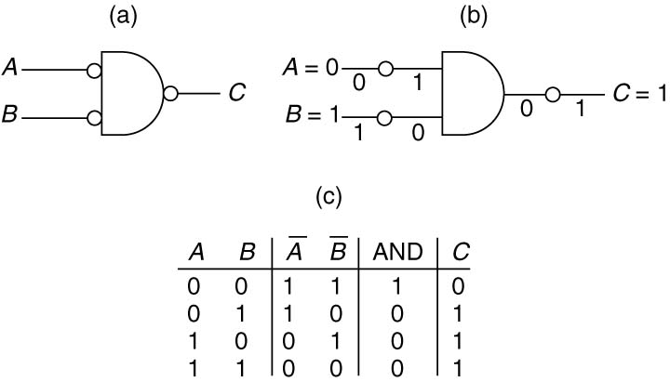
Figure 3.9 DeMorgan’s Law

Slide 14
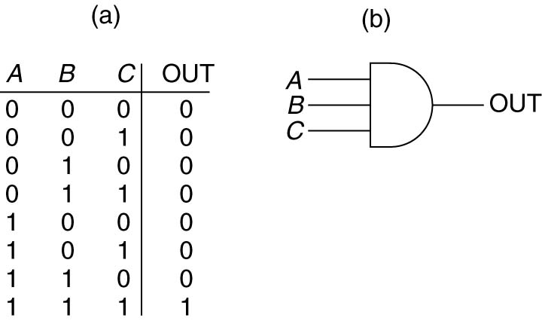
Figure 3.10 A Three-Input AND Gate

Slide 15
Combinational Logic Circuits
Structures whose outputs are strictly dependent on the current combination of input values.
Outputs are not at all dependent on any past history of information that is stored internally.
No information can be stored internally
Decoder
Multiplexer
Full Adder

Slide 16
Representations of Logic Functions
Truth tables – most abstract representation, specifies only what the function does but not how it does it.
Boolean expressions – specifies what the function does and how it does it.
Logic diagrams – shows the interconnection of logic gates and corresponds most closely to the hardware.

Slide 17
Implementation of Logic Functions
Write down the truth table for the function.
Provide inverters to generate the complement of each input.
Draw an AND gate for each term with a 1 in the result column.
Wire the AND gates to the appropriate inputs.
Feed the output of all the AND gates into an OR gate.

Slide 18
Decoders
Translates a logical encoding into a spatial location
Exactly one of its outputs is 1 and all the rest are 0s
In general,
n inputs
2^{n} outputs
The output line that detects the input pattern is asserted

Slide 19
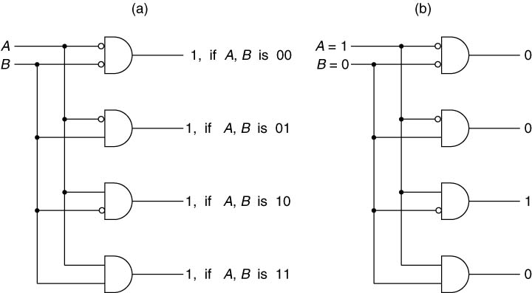
Figure 3.11 A Two-Input Decoder

Slide 20
Multiplexers
A MUX connects a number of inputs to a single output
The select signal (S) determines which input is connected to the output
In general,
2^{n} inputs
n select lines

Slide 21
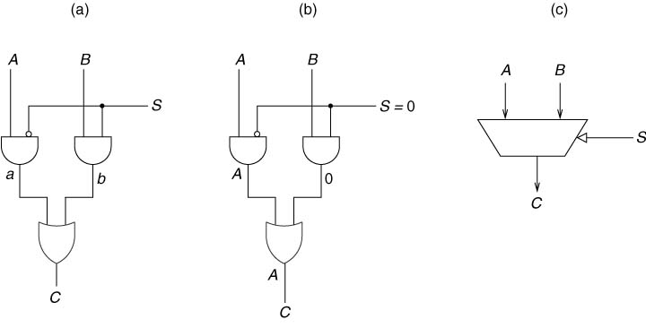
Figure 3.12 A 2-1 MUX

Slide 22
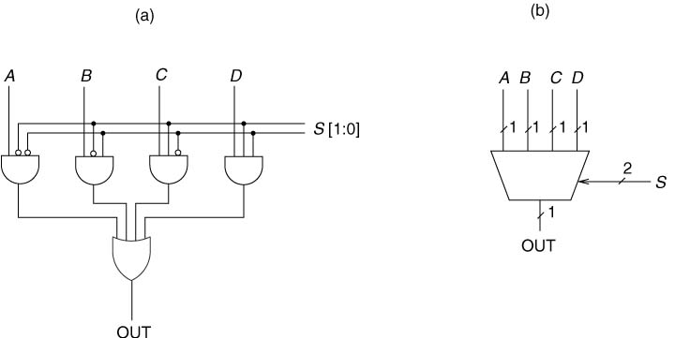
Figure 3.13 A 4-Input MUX

Slide 23
Full Adder
A logic circuit that implements binary addition of two n-bit operands, from right to left, one column at a time, including the carry from the previous column

Slide 24
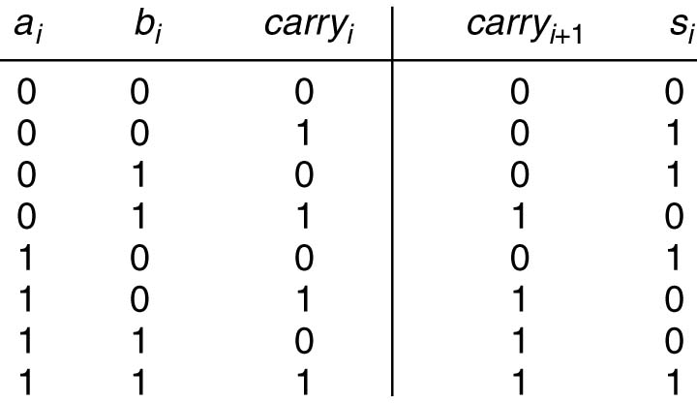
Figure 3.14 Truth Table for a Binary Adder

Slide 25
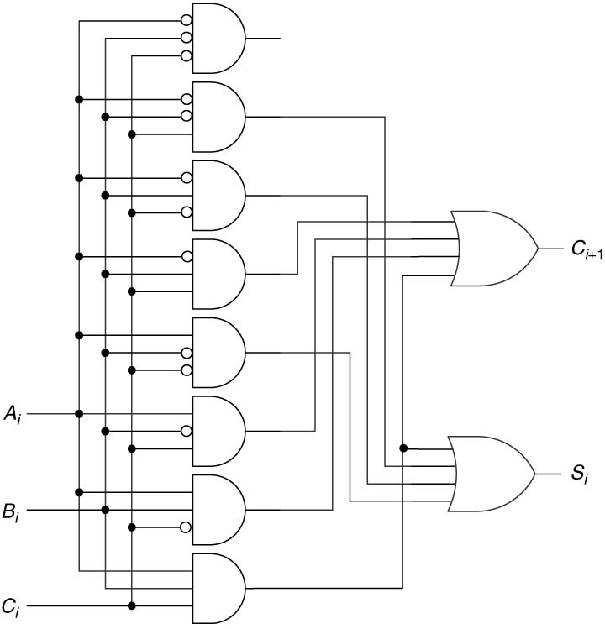
Figure 3.15 Gate-level Description of a Full Adder

Slide 26
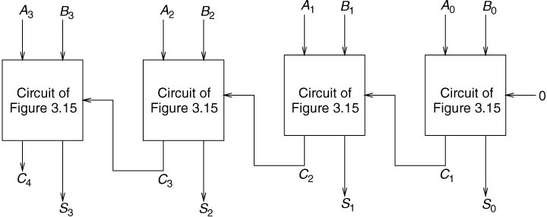
Figure 3.16 A Circuit for adding two 4-bit Binary Numbers

Slide 27
Programmable Logic Array (PLA)
A component that consists of a customizable AND matrix followed by a customizable OR matrix
The number of AND gates corresponds to the number of input combinations (Rows) in the truth table
The number of OR gates corresponds to the number of output columns in the truth table
In general,
n input logic functions requires 2^{n} n-input AND gates
Connect the output of an AND gate to the input of an OR gate if the corresponding row of the truth table produces an output of 1 for that output column

Slide 28
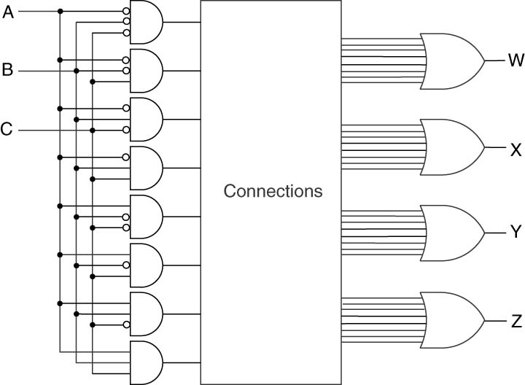
Figure 3.17 A Programmable Logic Array (PLA)

Slide 29
Basic Storage Elements
Allows logic structures to store information
The R-S Latch
The Gated D Latch
A Register

Slide 30
The R-S Latch
Stores 1 bit of information
Start at quiescent state where both S and R inputs have a logic value of 1
Case 1: output a = 1
Latch stores a ‘1’
Case 2: output a = 0
Latch stores a ‘0’
To set the latch to 1, momentarily clear S
To set the latch to 0, momentarily clear R

Slide 31
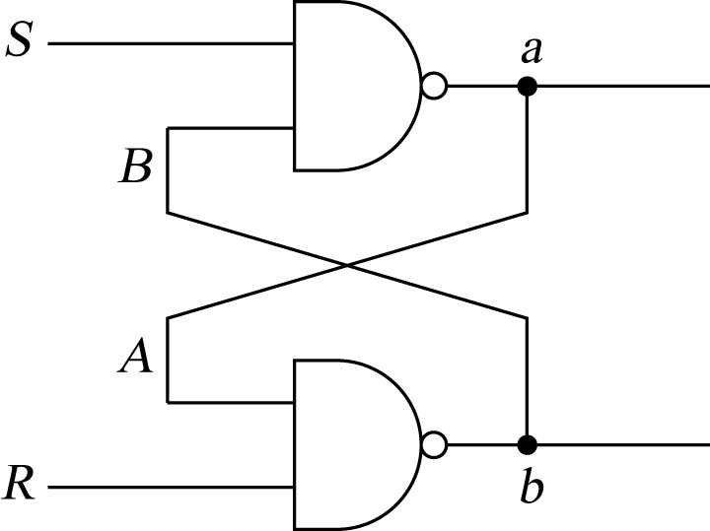
Figure 3.18 An R-S Latch

Slide 32
The Gated D Latch
Allows control of the value stored in the latch
Uses an R-S latch
Uses a write enable (WE) input to control when the latch will be set to the value of the input (D)

Slide 33
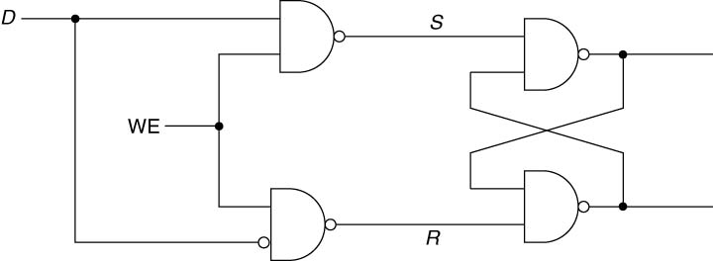
Figure 3.19 A Gated D Latch

Slide 34
A Register
A structure that stores a number of bits, taken together as a unit
LC-3 uses 16-bit and one-bit registers
16-bit regs: PC, IR, MAR
1-bit regs: N, Z, P

Slide 35
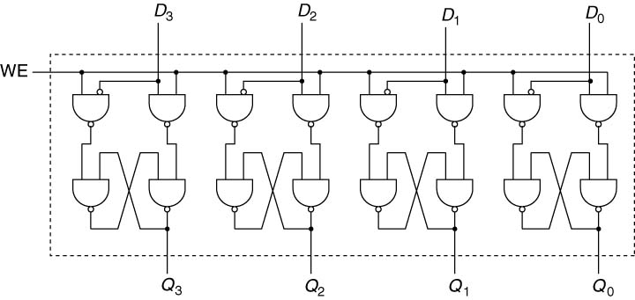
Figure 3.20 A Four-bit Register

Slide 36
Memory
Consists of a large number of locations, each uniquely identifiable and each having the ability to store a value
Address: uniquely identifies a memory location

Slide 37
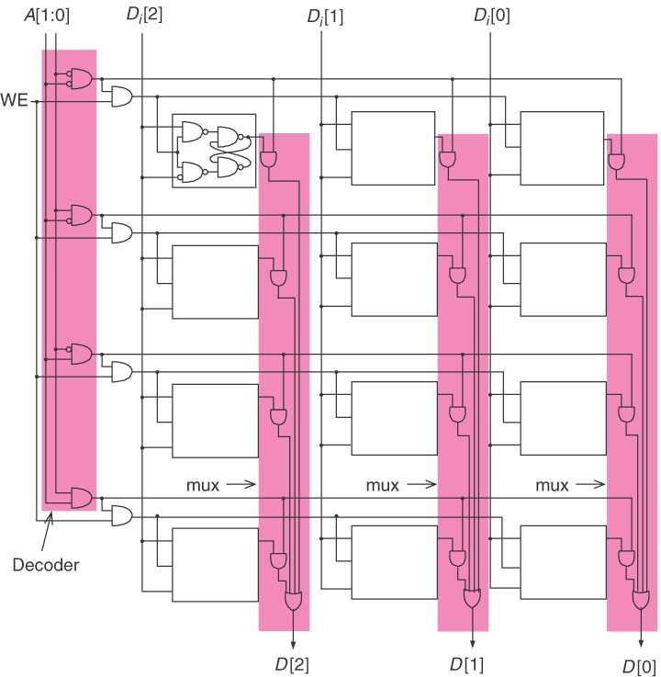
Figure 3.21 A 2²-by-3-bit Memory

Slide 38
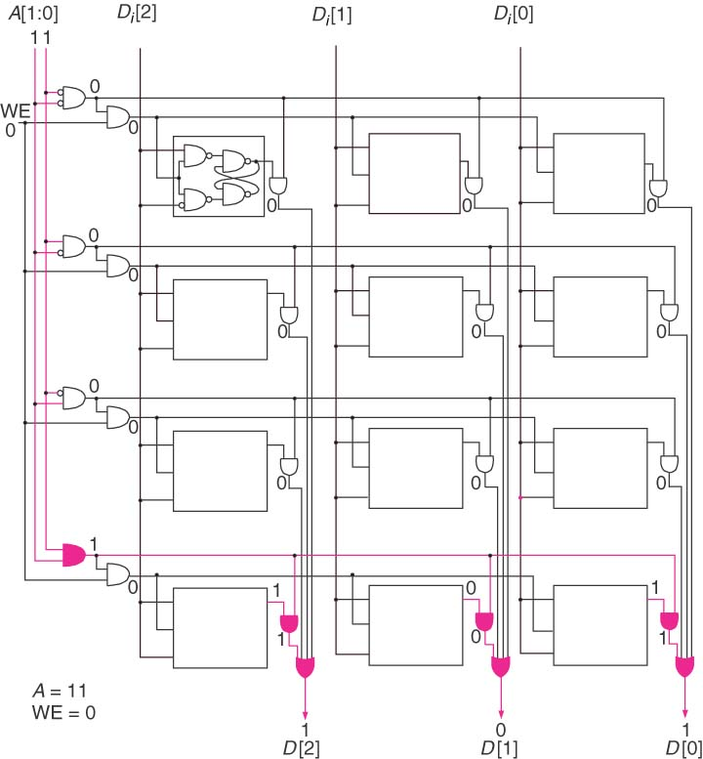
Figure 3.22 Location 3 in the 2²-by-3-bit Memory

Slide 39
Sequential Logic Circuits
Logic structures that can both process information and store information
Decisions are based on current AND previous inputs

Slide 40
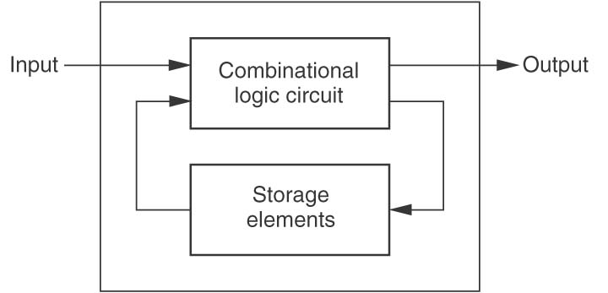
Figure 3.23 Sequential Logic Circuit Block Diagram

Slide 41
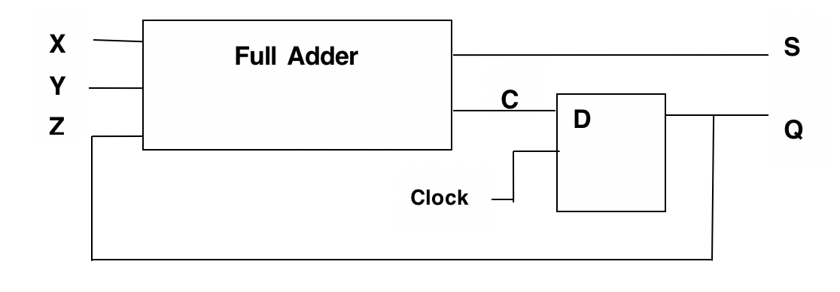
Example Sequential Circuit

Slide 42
Truth Table Full Adder Sequential Circuit

Slide 43
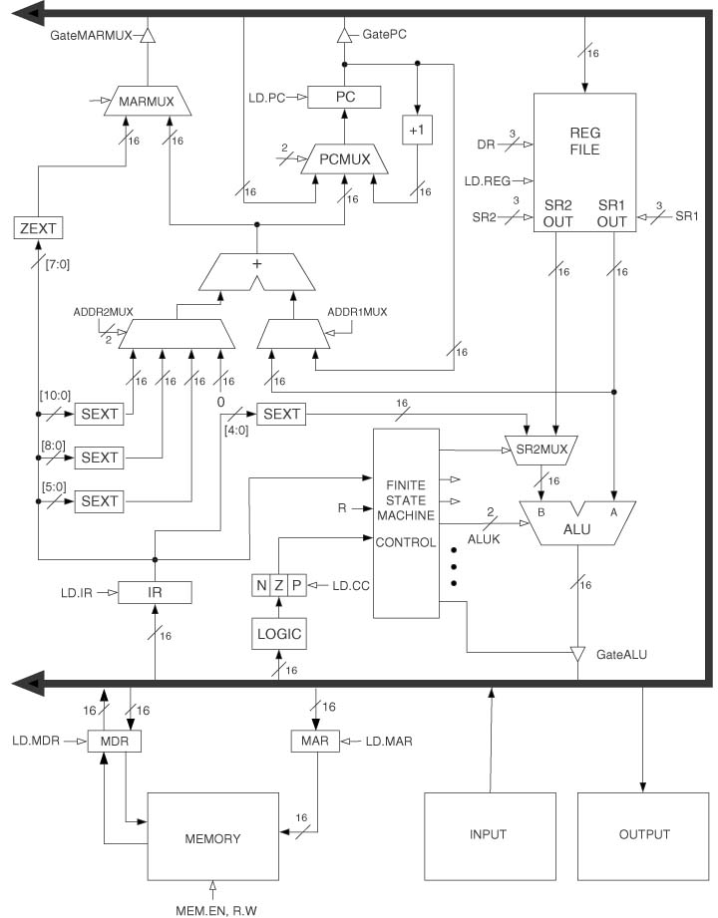
LC-3 Data Path

Slide 44
Reading Assignment
Chapter 4 The von Neumann Model

